Slide 1
The Fundamental of Mobile Robot
Machine Perception and Interaction Group (MPIG)
http://www.mpig.com.cn
szl@mpig.com.cn

Slide 2
Send an email with specified subject ‘Robot stuff’ to
assignments.shmtu@gmail.com
An automatic reply will come.
All you need would be included!

Slide 3

assignments.shmtu@gmail.com

Slide 4


All the codes accompanying this course are open-sourced at Github.
The project homepage:
https://github.com/sunzuolei/robotcourse
The git repository:
https://github.com/sunzuolei/robotcourse.git
Learn more about git:
http://en.wikipedia.org/wiki/Git_(software)
The best GUI-based git client on Windows:
https://code.google.com/p/tortoisegit/

Slide 5
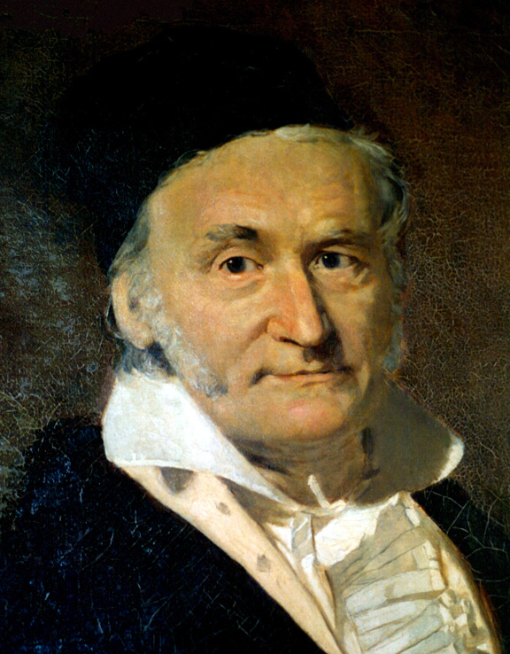
Gaussian Distribution
30 April 1777 – 23 February 1855
German mathematician and physical scientist
https://en.wikipedia.org/wiki/Normal_distribution

Slide 6
Variance

Slide 7
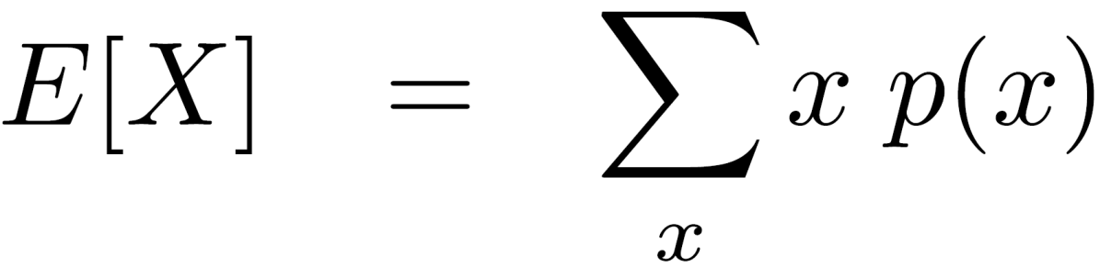

What is this?

Slide 8





17
19
18
17
19
Expectation
Mean

Slide 9
17
19
18
17
19
What is the expectation of the five students?

Slide 10
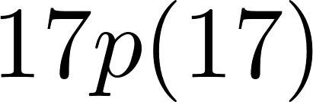
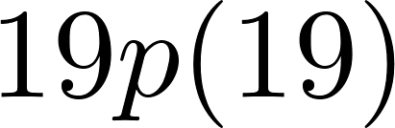
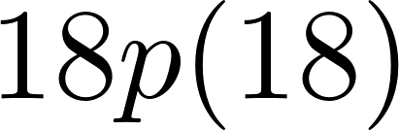

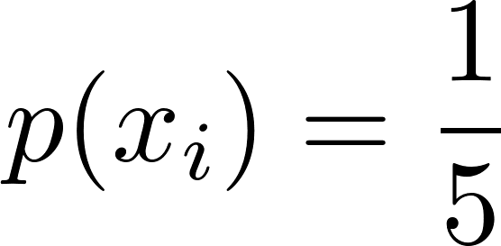
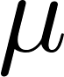
17
19
18
17
19
The uniform distribution
18
Expectation

Slide 11
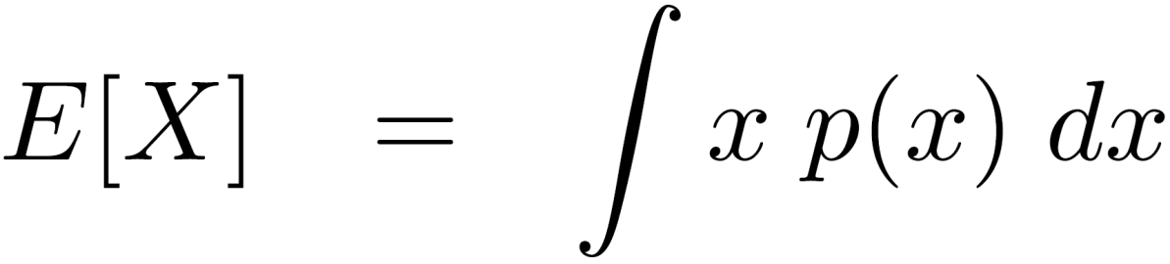
Continuous space
Discrete space
Expectation

Slide 12





18
17
19
18
17
19
7
38
4
23
18

Slide 13
18
17
19
18
17
19
18
7
38
4
23
18
Are the two datasets with the same expectation the same?

Slide 14
18
17
19
18
17
19
18
7
38
4
23
18
The former samples are clustered
very close to 18 whereas the latter samples are really far from 18 in most cases.

Slide 15
18
17
19
18
17
19
18
7
38
4
23
18
The E doesn’t capture the spread of the data. Can we calculate this somehow?

Slide 16
18
17
19
18
17
19
-1
1
0
-1
1
0
18
7
38
4
23
18
-11
20
-14
5
0
0
Subtract the mean / E from each data item then compute the E.

Slide 17
18
17
19
18
17
19
-1
1
0
-1
1
0
1
1
0
1
1
0.8
Mean
18
7
38
4
23
18
-11
20
-14
5
0
0
121
400
196
25
0
148.4
Mean

Slide 18
18
Mean
17
19
18
17
19
0.8
Variance
18
Mean
7
38
4
23
18
148.4
Variance
The variance is a measure of how far the data is spread. It's small if the data is centered around the mean, it's large if the data falls far away from the mean.

Slide 19
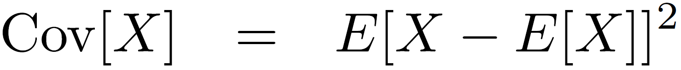
18
Mean
17
19
18
17
19
0.8
Variance
18
Mean
7
38
4
23
18
148.4
Variance

Slide 20
Expectation / Mean
(Co)Variance

Slide 21
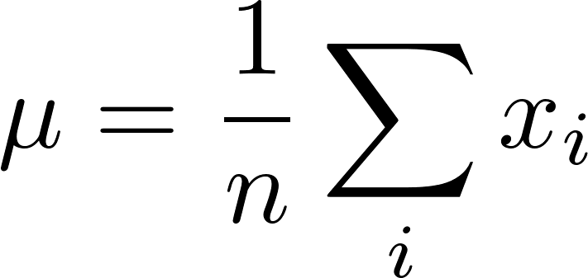
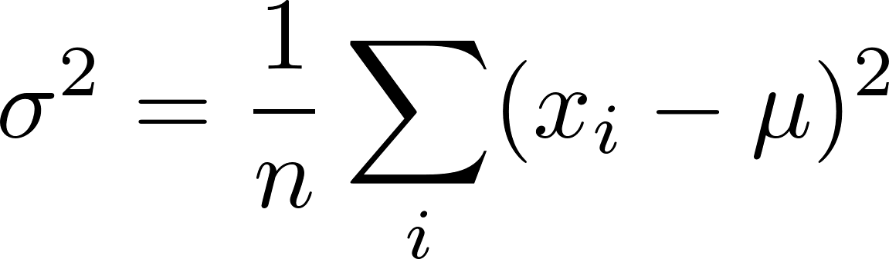
Expectation / Mean
(Co)Variance

Slide 22
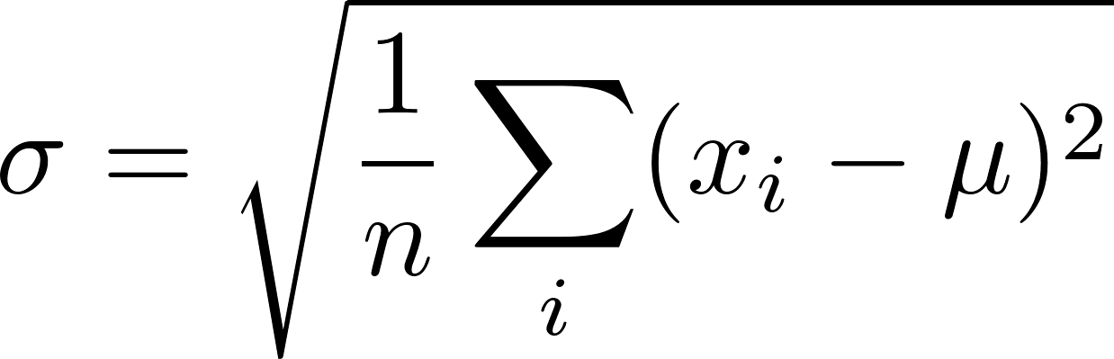
Variance is the average quadratic deviation from the mean. If taking the square root of it, then we get standard deviation.
Let’s implement this!
(Co)Variance

Slide 23
function mu = compMean(x)
mu = sum(sum(x))/ (size(x,1) * size(x,2));
end
function sigma2 = compVariance(x)
mean = inline('sum(sum(x))/ (size(x,1)*size(x,2))');
mu = mean(x);
x2 = (x-mu).^2;
sigma2 = mean(x2);
end
P13

Slide 24
x = [7, 38, 4, 23, 18];
mu = compMean(x);
sigma2 = compVariance(x);
fprintf('The Expectation / Mean:\t %.1f \n', mu);
fprintf('The Variance is:\t\t %.1f \n', sigma2);
fprintf('The Standard Deviation is:\t %.1f \n', sqrt(sigma2));
P13

Slide 25





18
18
18
18
18
What are the mean, variance and SD?
What does they mean?

Slide 26
Mean
18
Variance
0
Standard Deviation
0
18
18
18
18
18
No spread at all in the data.

Slide 27
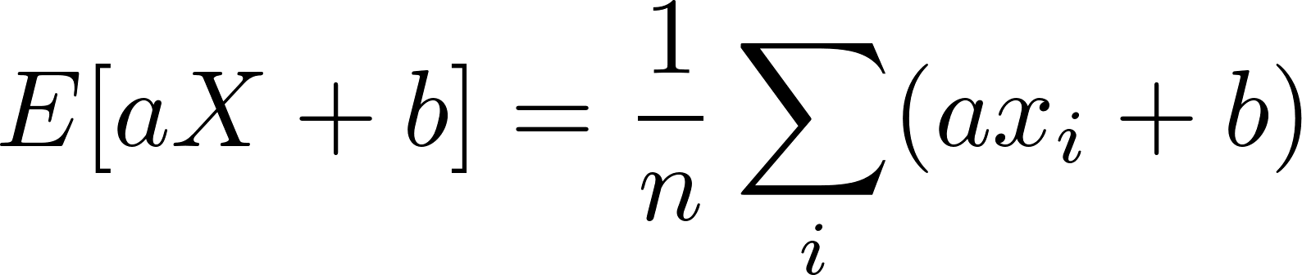
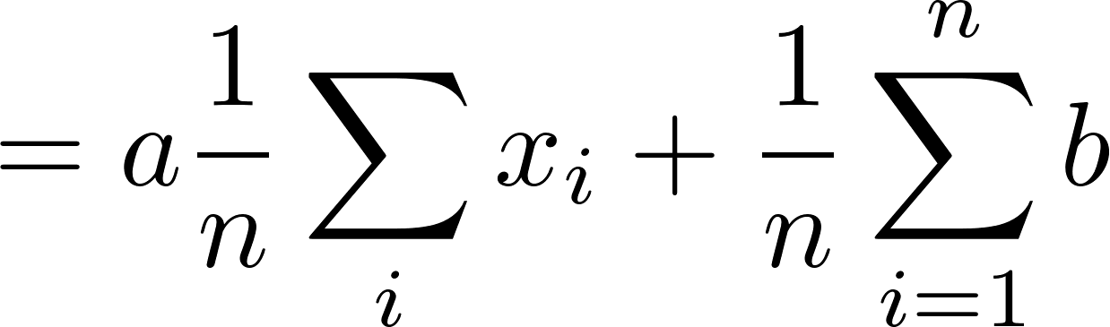
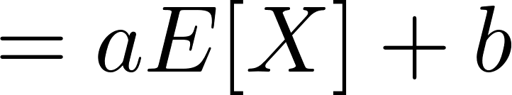
Expectation \ Mean is additive

Slide 28
Expectation \ Mean is additive
Let’s prove this by programming!

Slide 29
path(path,genpath('../p13'));
a = 2;
b = 4;
x = [7, 38, 4, 23, 18];
y = a*x + b;
xmu = compMean(x);
ymu = compMean(y);
fprintf('a * Xmu + b \t= %.2f \n', a * xmu + b);
fprintf('Ymu \t\t= %.2f \n', ymu);
P14

Slide 30

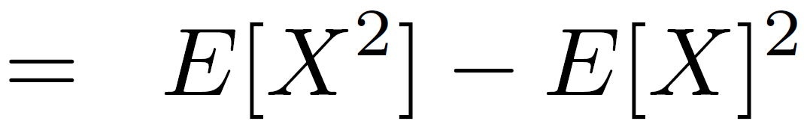
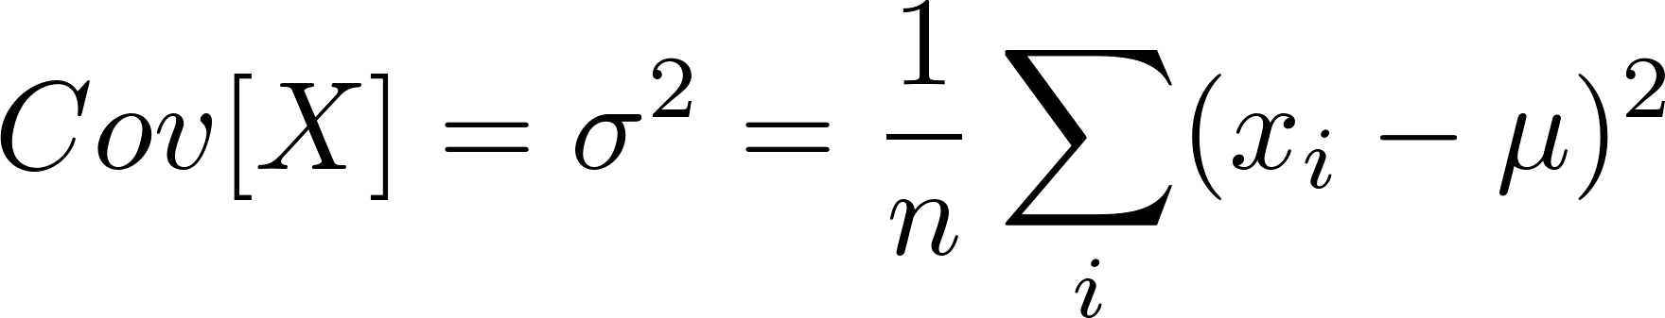
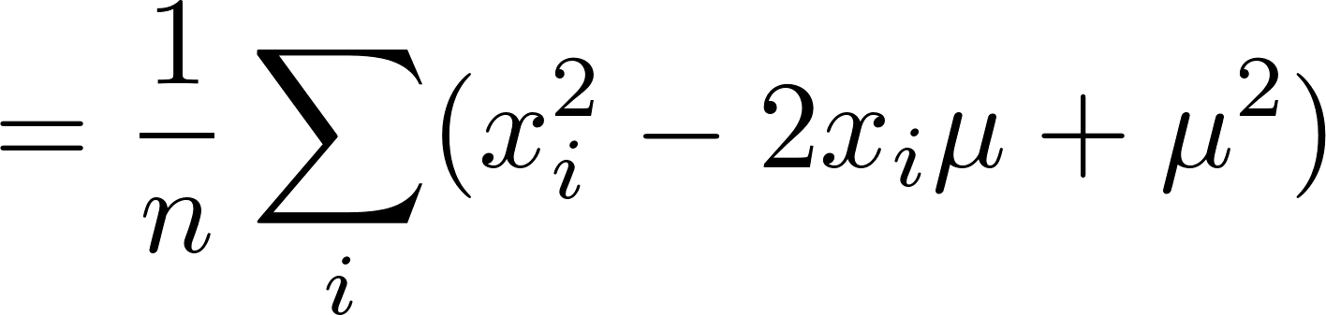
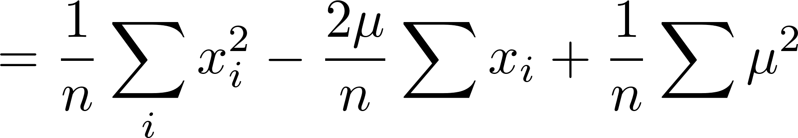
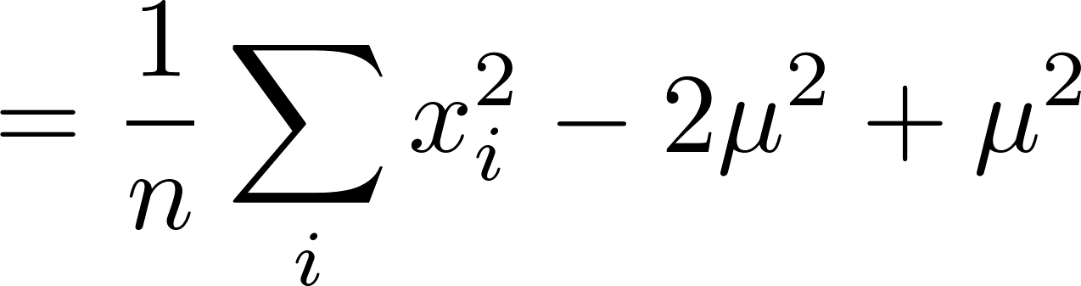
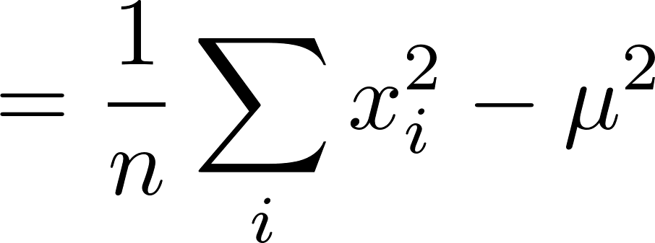
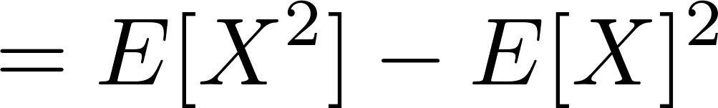
Let’s prove this by programming!

Slide 31
path(path,genpath('../p13'));
x = [7, 38, 4, 23, 18];
x2 = x.^2;
x2mu = compMean(x2);
xmu = compMean(x);
xvar = compVariance(x);
fprintf('The Variance of X \t= %.2f \n', xvar);
fprintf('E[X^2]-E[X]^2 \t\t= %.2f \n', x2mu - xmu^2);
P15

Slide 32
Covariance Matrix: Extend Variance to 2D

Slide 33
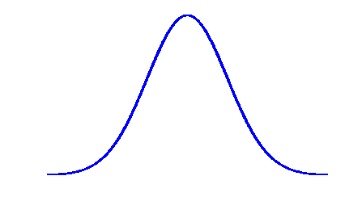
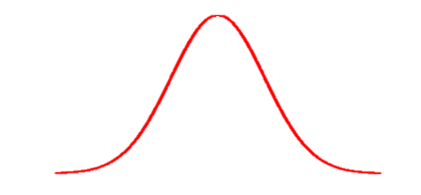

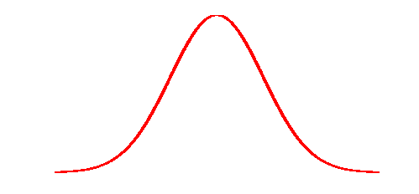
Covariance
Variance

Slide 34
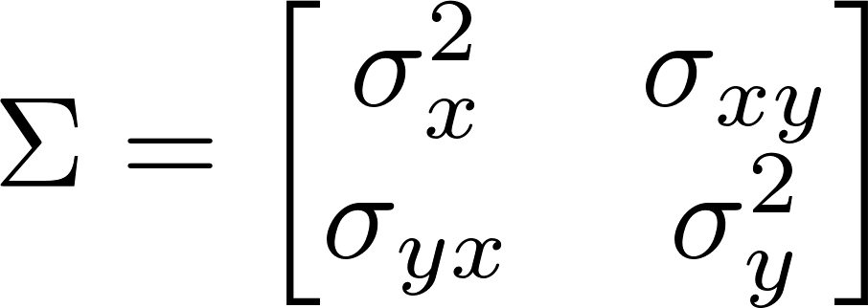
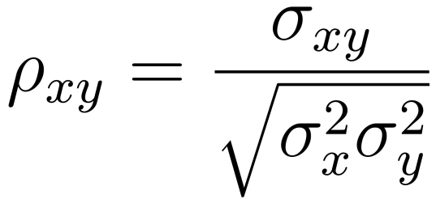
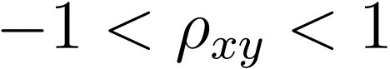
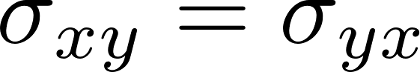
Covariance Matrix
Correlation
coefficient
Can you guess the shape of covariance matrix?

Slide 35
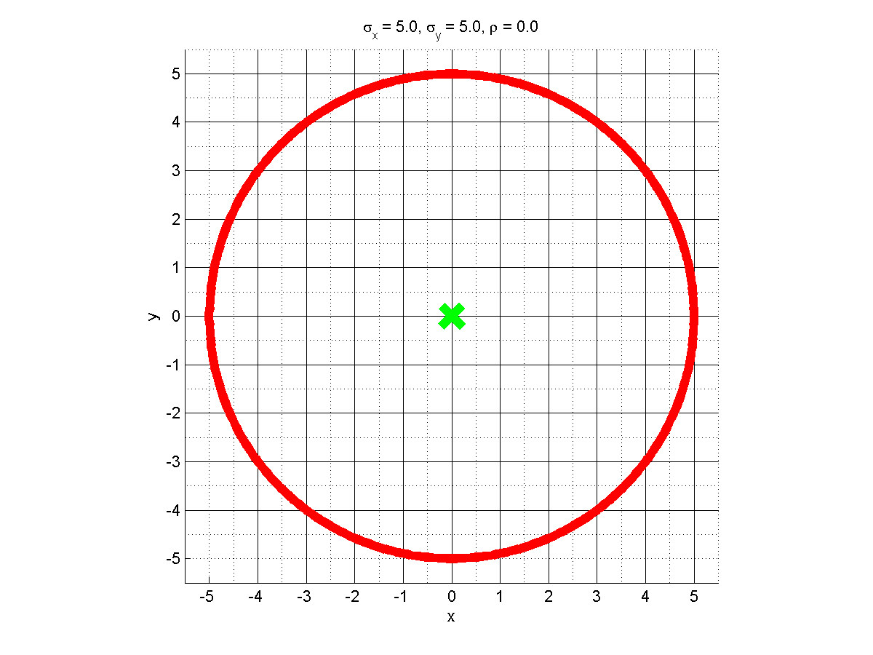

Slide 36
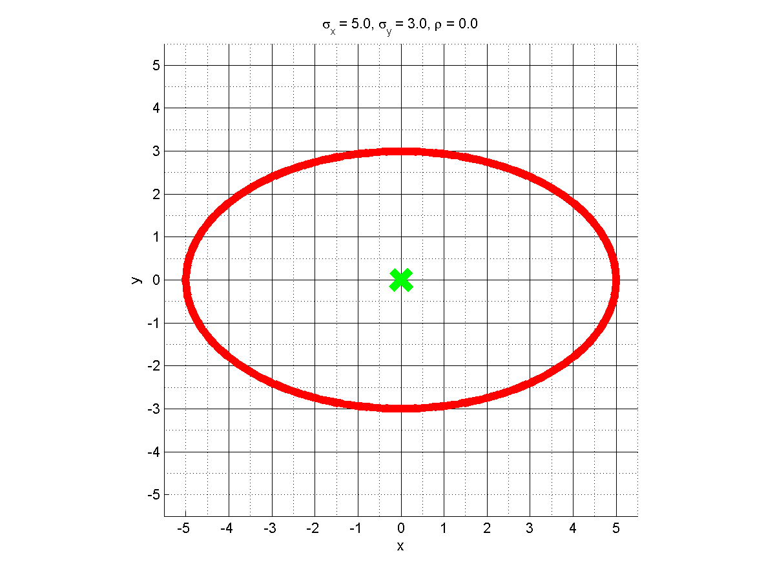

Slide 37
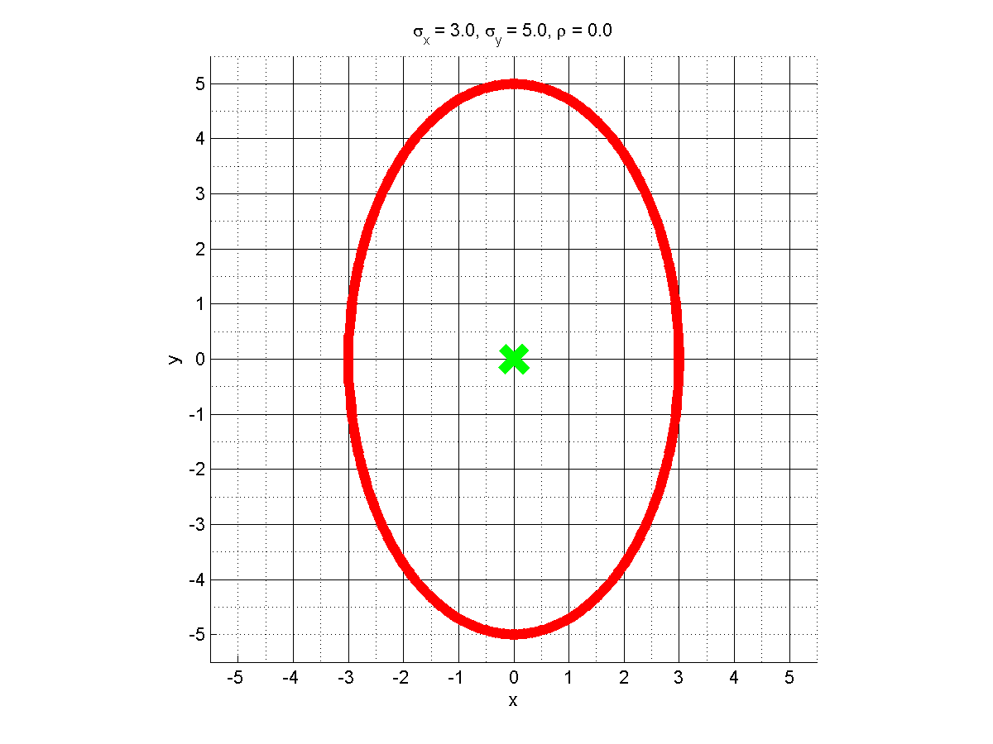

Slide 38
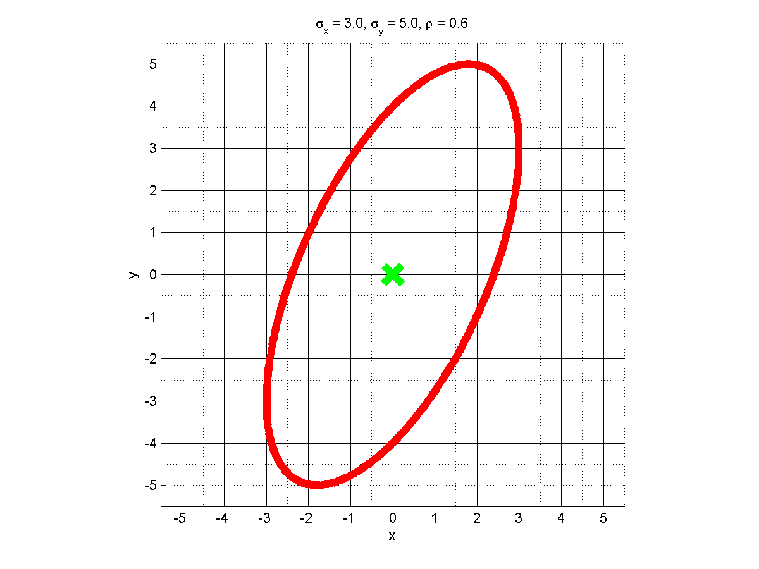

Slide 39
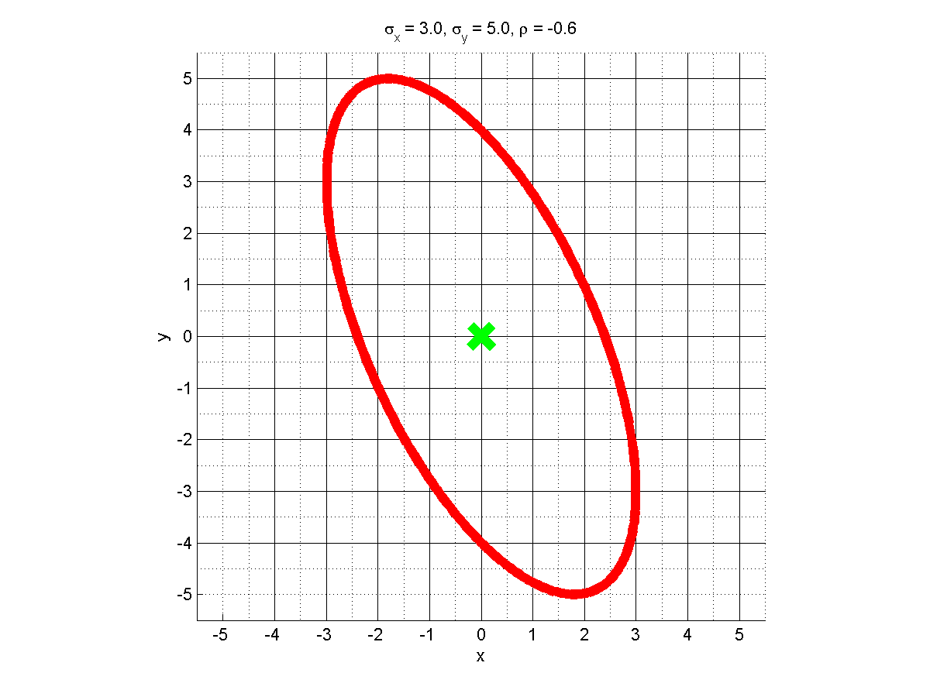

Slide 40
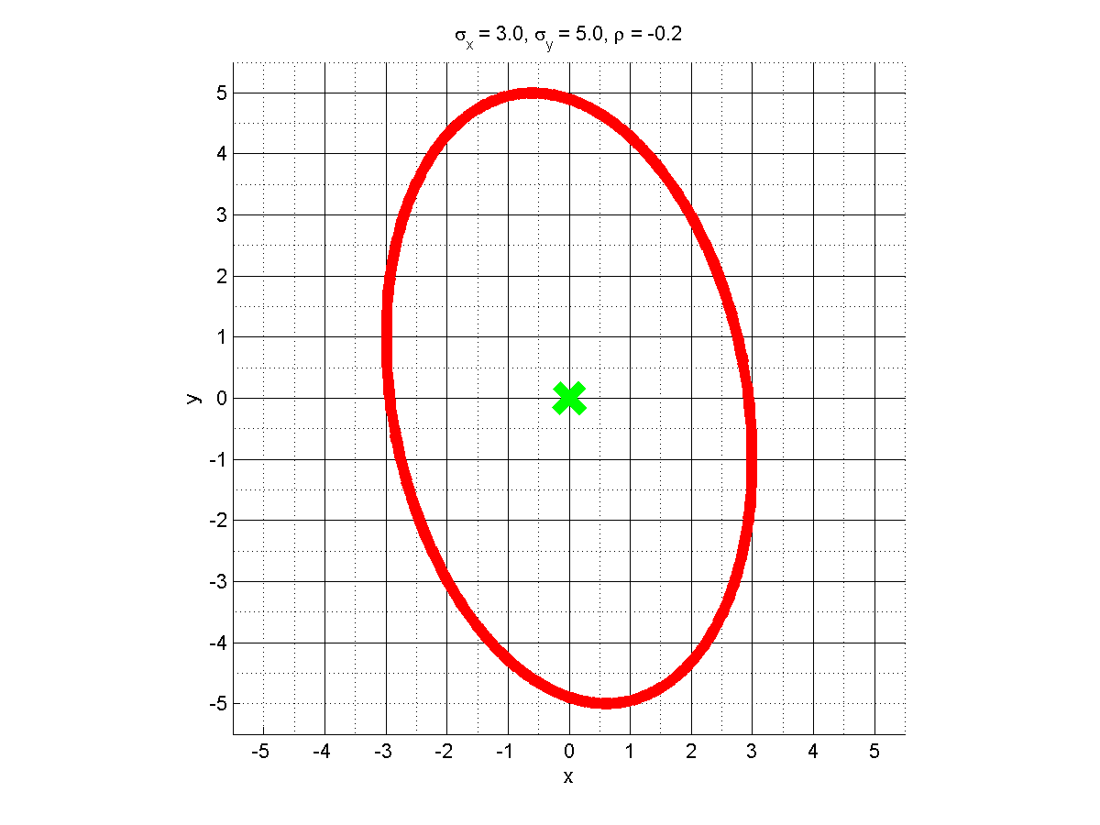

Slide 41
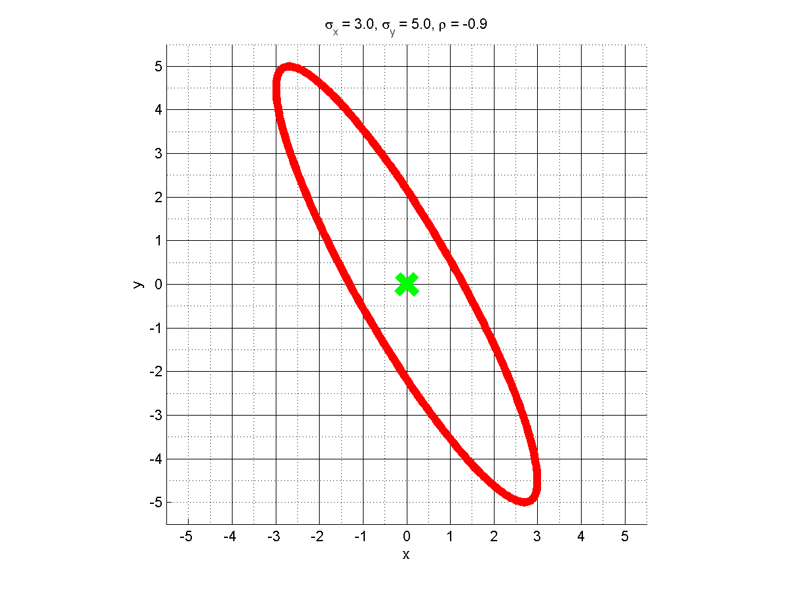
Let’s implement this!

Slide 42
mu = [0, 0];
sigmax = 3;
sigmay = 5;
rho = -0.2;
sigmaxy = sigmax * sigmay * rho;
Sigma = [sigmax^2, sigmaxy;
sigmaxy, sigmay^2];
ellipse = getSigmaEllipse(mu, Sigma, 1, 360);
P16

Slide 43
h = figure('name', 'The 1-sigma ellipse');
hold on;
plot(ellipse(1,:), ellipse(2, :), 'r-', 'linewidth', 6);
plot(mu(1), mu(2), 'xg', 'markersize', 20, 'linewidth', 6);
xlabel('x');
ylabel('y');
title(sprintf('\\sigma_x = %.1f, \\sigma_y = %.1f, \\rho = %.1f',...
sigmax, sigmay, rho));
grid on;
axis equal;
xlim([-5.5, 5.5]);
ylim([-5.5, 5.5]);
set(gca, 'XTick', -5 : 1 : 5);
set(gca, 'YTick', -5 : 1 : 5);
grid minor;
P16

Slide 44
Covariance Matrix: Extend Variance to ND

Slide 45
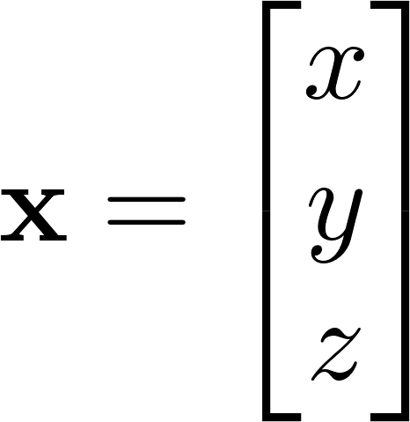
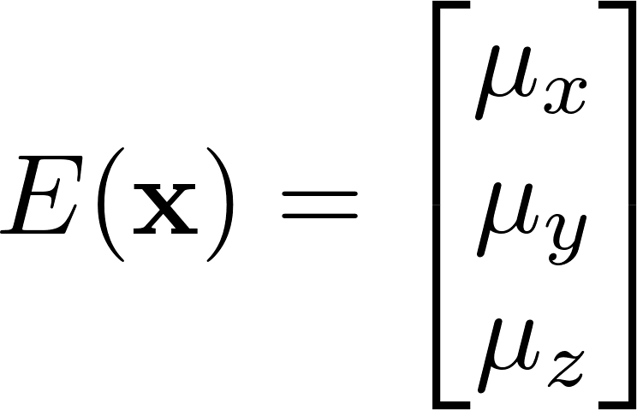
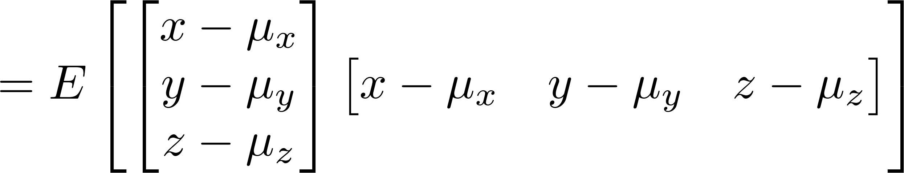
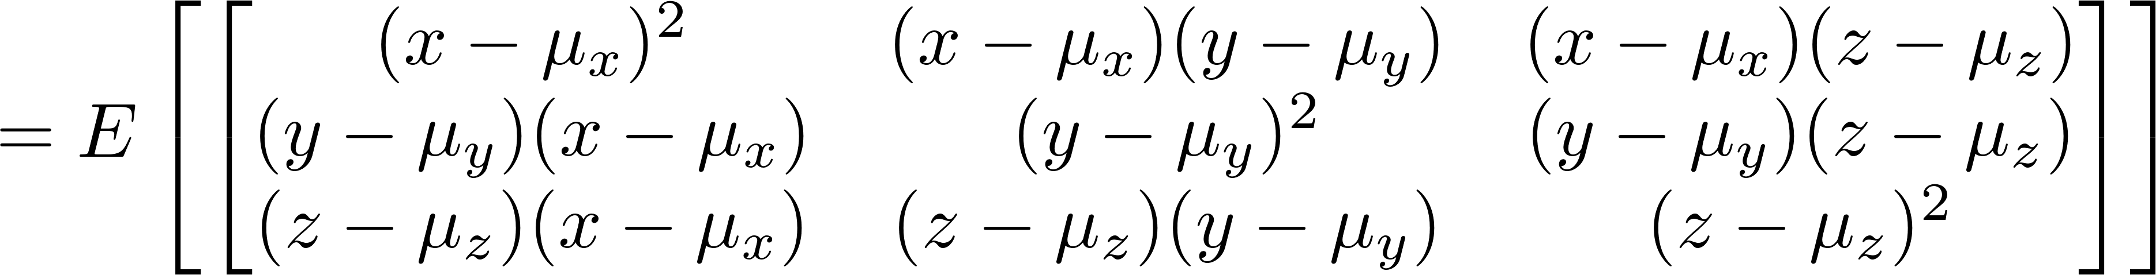

Slide 46
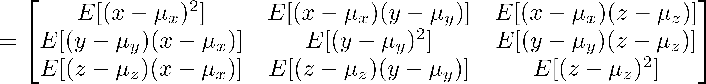

Slide 47
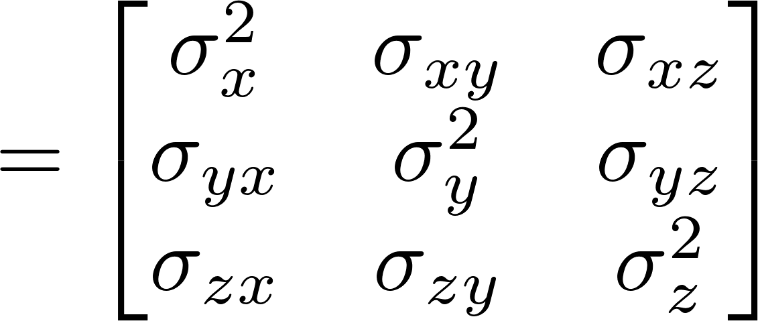

Slide 48
68–95–99.7 Rule
or Three-Sigma Rule, or Empirical Rule
http://en.wikipedia.org/wiki/Three_sigma_rule

Slide 49
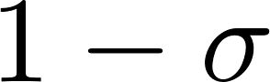
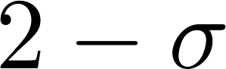
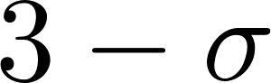
68.27%
About 68.27% of the values lie within 1 standard deviation of the mean.
95.45%
About 95.45% of the values lie within 2 standard deviations of the mean.
99.73%
Nearly all (99.73%) of the values lie within 3 standard deviations of the mean.

Slide 50
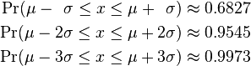


Slide 51
Gaussian Distribution
or Normal Distribution
http://en.wikipedia.org/wiki/Gaussian_Distribution

Slide 52
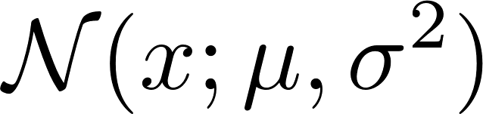
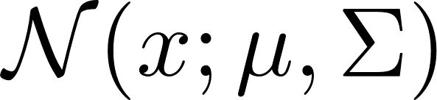
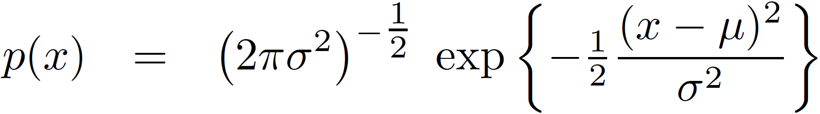
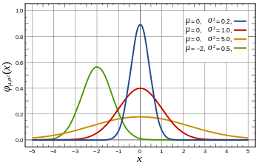
1D

Slide 53


Slide 54


Slide 55

Let’s implement this!

Slide 56
x = -2 : 0.01 : 12;
mu = 5;
sigma = 0.5;
p = gaussian1d(mu, sigma, x);
%%
h = figure('name','One D Gaussian distribution');
hold on;
plot(x, p, 'b-', 'linewidth', 4);
plot([mu, mu], [min(p), max(p)], 'r-', 'linewidth', 4);
box on;
title(sprintf('\\mu = %.1f, \\sigma = %.1f', mu, sigma))
% set(gca,'Visible','off');
xlabel('x');
ylabel('P(x)');
grid on;
grid minor;
print(h, '-dpng', 'guassian1d.png');
P17

Slide 57
function p = gaussian1d(mu, sigma, x)
p = 1 / (sigma * sqrt(2 * pi)) * ...
exp(-(x - mu).^2 / (2 * sigma^2));
End
fprintf('The integration of p with respect to x is %.f\n', trapz(x, p));
Computes an approximation of the integral of Y via the trapezoidal method (with unit spacing).
P17

Slide 58


Slide 59

1D
Multi- dimensional
Normal (Gaussian) distributions over vectors are called multivariate.
Let’s implement this!

Slide 60


Slide 61


Slide 62


Slide 63
function [pMat, xMat, yMat] = gaussian2d(mu, Sigma, x, y)
xLen = length(x);
yLen = length(y);
[xMat, yMat] = ndgrid(x, y);
% xMat = [x1, x1;
% x2, x2],
% yMat = [y1, y2;
% y1, y2]
for i = 1 : xLen
for j = 1 : yLen
xMinusMu = [xMat(i, j) - mu(1); yMat(i, j) - mu(2)];
p = exp(-0.5 * xMinusMu'* inv(Sigma) * xMinusMu);
p = p * det(2 * pi * Sigma)^(-0.5);
pMat(i, j) = p;
end
end
end
P18

Slide 64

mu = [6, 5];
sigmax = 2;
sigmay = 1;
rho = -0.2;
sigmaxy = sigmax * sigmay * rho;
Sigma = [sigmax^2, sigmaxy;
sigmaxy, sigmay^2];
x = 0 : 0.01 : 12;
y = x;
[pMat, xMat, yMat] = gaussian2d(mu, Sigma, x, y);
fprintf('The integration of p with respect to x and y is %.4f\n',...
trapz(y, trapz(x,pMat)));
P18

Slide 65
Linear Transformation of Gaussian

Slide 66



Slide 67
Expectation / Mean
(Co)Variance

Slide 68



Slide 69
Expectation / Mean
(Co)Variance

Slide 70


Slide 71



Slide 72
Expectation / Mean
(Co)Variance

Slide 73


Slide 74
1D

Slide 75





ND

Slide 76
Feed Bayes filtering with Gaussian Distribution

Slide 77







0.2
0.2
0.2
0.2
0.2
Red * 0.6
Green *0.2
Z

Slide 78




Z

Slide 79

Convolution
Product

Slide 80
Convolution
Prediction
Product
Update
What are the convolution and the product of two Gaussian distribution like?

Slide 81





Convolution
Prediction
Product
Update
Convolute

Slide 82



Convolution
Prediction
Convolute

Slide 83

Convolution
Product
Update
Prediction

Slide 84
Convolution
Product
Update
Prediction
Convolution
Prediction
http://tina.wiau.man.ac.uk/docs/memos/2003-003.pdf

Slide 85



Prior
Motion model
Predicted
Convolute
Posterior
Sensor model
Predicted
Let’s implement this!

Slide 86

P19

Slide 87

In an estimation-theoretic context
Entropy
Informative
Uncertainty
Localization complies with this rule!

Slide 88
P19

Slide 89
P19
path(path, genpath('../p17'));
x = -10:0.01:10;
prior = gaussian1d(2, 1, x); % a Gaussian Prior of mean 2 and SD 1
motionModel = gaussian1d(1, 2, x); % a Gaussian motion model of mean 1 and SD 2
sensorModel = gaussian1d(5, 1, x); % a Gaussian observation model of mean 5 and SD 1
probAfterMove = convolute1d(motionModel, prior, x); % prediction is convolution
probAfterSense = product1d(sensorModel, probAfterMove, x); % update is multiplication

Slide 90
P19
function fxy = product1d(fx,fy,x)
fxy = fx.*fy; % multiply
fxy = fxy / trapz(x,fxy); % normalize
function fxy=convolute1d(fx,fy,x)
fxy = conv(fx, fy, 'same');
fxy = fxy / trapz(x,fxy); % normalize

Slide 91
Convolution
Product
Update
Prediction
Convolution
Prediction
Let’s program to prove this!
Are the results of the two methods the same?

Slide 92
P20
function [muAfterMove, sdAterMove] = convolute1dParam(...
muPrior, sdPrior, muMotion, sdMotion)
muAfterMove = muPrior + muMotion;
sdAterMove = sqrt(sdPrior^2 + sdMotion^2);
end

Slide 93
P20
function [muPost, sdPost] = product1dParam(...
muAfterMove, sdAfterMove, muSensor, sdSensor)
muPost = (muAfterMove * sdSensor^2 + muSensor * sdAfterMove^2) / ...
(sdAfterMove^2 + sdSensor^2);
sdPost = (sdSensor^2 * sdAfterMove^2) / ...
(sdAfterMove^2 + sdSensor^2);
end

Slide 94

P20

Slide 95



Covariance
Z

Slide 96


Slide 97


Slide 98

Predicted

Slide 99


Slide 100
P21
path(path, genpath('../p18'));
path(path, genpath('../p11'));
x = -2 : 0.02 : 10;
y = x;
%% Prior
[priorMat, xMat, yMat] ...
= gaussian2d([5, 6], makeSigma(0.6, 0.9, 0.7), x, y);
%% Motion model
motMat = gaussian2d([3, 2], makeSigma(0.4, 0.7, 0.3), x, y);
%% Observation model
obsMat = gaussian2d([6, 4], makeSigma(0.6, 0.5, 0.5), x, y);
%% Prediction
predMat = convolute2d(priorMat, motMat, x, y);
%% Update
postMat = product2d(predMat, obsMat, x, y);

Slide 101
P21
function p = convolute2d(p1, p2, x, y)
p = conv2(p1, p2, 'same');
p = p / trapz(y, trapz(x,p));
end
function p = product2d(p1, p2, x, y)
p = p1.* p2;
p = p / trapz(y, trapz(x,p));
end

Slide 102
Why is the Gaussian special?

Slide 103
All PDFs have a mean and covariance, but
Only Gaussians are completely described by these parameters (ie, sufficient statistics)
If given only the mean and variance, Gaussians are the maximum entropy PDF.
http://en.wikipedia.org/wiki/Moment_(mathematics)

Slide 104
The principle of maximum entropy implies that
If all we know is the mean and variance of a PDF, the most conservative shape to assume is the Gaussian. To presume any other PDF shape is to presume we know something more than what we have been given.

Slide 105
Gravitating property (the central limit theorem)
In probability theory, the central limit theorem (CLT) states that, given certain conditions, the mean of a sufficiently large number of independent random variables, each with a well-defined mean and well-defined variance, will be approximately normally distributed.
http://en.wikipedia.org/wiki/Central_limit_theorem

Slide 106
Sound computational properties
Linear transformation
Product
Convolution
https://en.wikipedia.org/wiki/Normal_distribution

